Slide 1
Value-based leadership for engaging with the SDGs
Pam fredman, professor
president
International Association of Universities

Slide 2
IAU-The International Association of Universities Building a Worldwide Higher Education Community
Founded 1950 by UNESCO
Non-Governmental Organization
Based at UNESCO Headquarters in Paris
>650 universities and 31 associations from 120 countries are Members
Strategic Priorities:
Internationalization
Leadership
Technology
Higher Education and Research for Sustainable Development (HESD)

Slide 3
Higher Education and Research for Sustainable Development (HESD)
Policy Statements:
IAU Kyoto Declaration (1993)
IAU Iquitos Statement (2014)
ABC-Strategy
Advocacy & Analyses
Building synergies & networking
IAU HESD Cluster
Key partner of the UNESCO GAP on ESD
Communicating & convening
Global portal
Publications

Slide 4
IAU Global Cluster on HESD

Slide 5
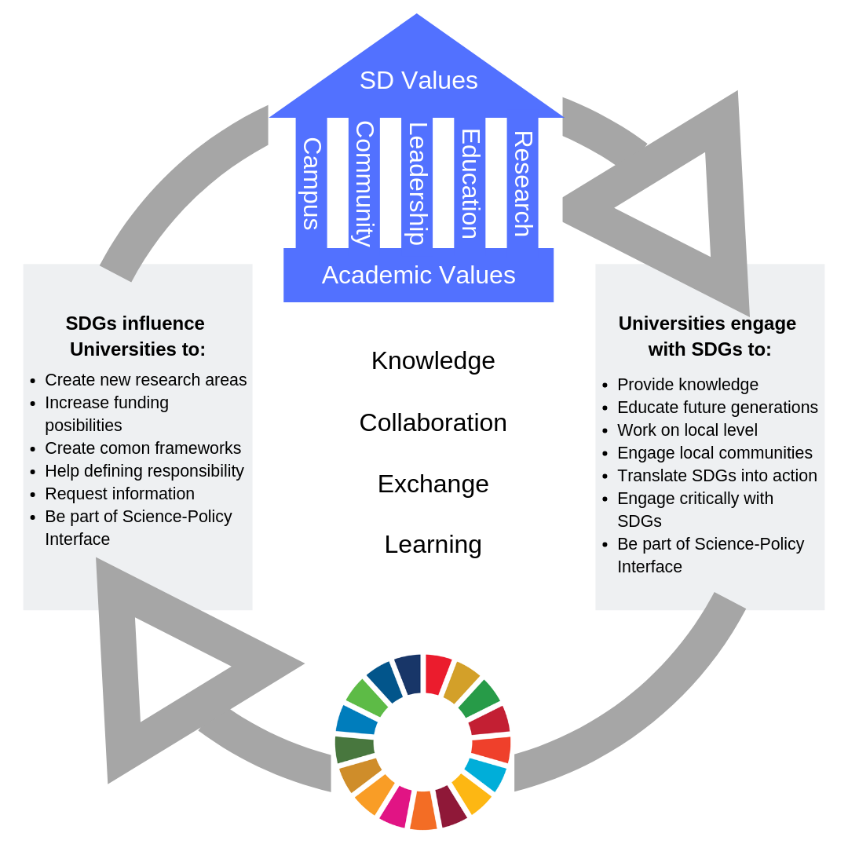
Win-Win Situation: HE & SDGs

Slide 6
Results of 2nd Global Survey on HESD (1)

Slide 7
Results of 2nd Global Survey on HESD (1)
Understanding of Agenda 2030 (0=nothing; 3=very knowledgeable)

Slide 8
Results of 2nd Global Survey on HESD (2)

Slide 9
Results of 2nd Global Survey on HESD (3)
Do you think that the adoption of the Sustainable Development Goals in 2015 increased the interest in sustainable development at your institution?

Slide 10
Results of 2nd Global Survey on HESD (4)

Slide 11
Results of 2nd Global Survey on HESD (5)

Slide 12
Results of 2nd Global Survey on HESD (6)

Slide 13
Value-based leadership for engaging with the SDGs

Slide 14
HE has a global key role in realizing the SDGs and a sustainable society
Value based knowledge creation and development and dissemination through research and education is crucial to the SDGs
Value of knowledge and seeking the “truth”
Value of academic skills through education
Value of local and global responsibility

Slide 15
Value-based?
Magna Charta Universitatum – Fundamental principles
Institutional autonomy
Academic freedom
Teaching and research inseparable
IAU Core Values
Institutional autonomy
Academic freedom
Social responsibility

Slide 16
Value based?
Institutional values expressed in mission/vision ex
Responsibility
Respect
Openness
Inclusion
Creativity
Innovation
Cross boundaries
……………………..

Slide 17
HE has a global key role in realizing the SDGs and a sustainable society: Conflicts/Obstacles
To academic freedom
earmark funding, demand on results, questioning of knowledge, etc
To institutional autonomy
stakeholder ( funding sources) influence/demands, commodification etc
To that research and education are inseparable
separate funding, commodification (employability) etc
To social responsibility
demand on “service for the local”, global ignorance

Slide 18
Value-based leadership for engaging with the SDGs- “living the values”
Internally
identify institutional values in the vision and mission of the institution
through an inclusive process, faculties, students and staff
develop value-based leadership at all levels
continuous monitoring of compliance in research and education
Externally
promote and defend and develop understanding of the values of HE and the institutional values
promote and advocate for the role of HE , research and education
To politicians/governments – value HE as a common good
To funding agencies/stakeholders of research and education

Slide 19
Value-based leadership for engaging with the SDGs

Slide 20
How do HEIs develop a value-based leaderhip for engaging with the SDGs
What are common fundamental values to HE and how are they reflected in institutional values in their mission and vision?
How do get faculties, students and staff involved?
How to continuously communicate the values with politicians and stakeholders to have them respect and support the values of HE
How do HEIs as a community get involved in policy- making activities on local/regional/global level?

